Slide 1
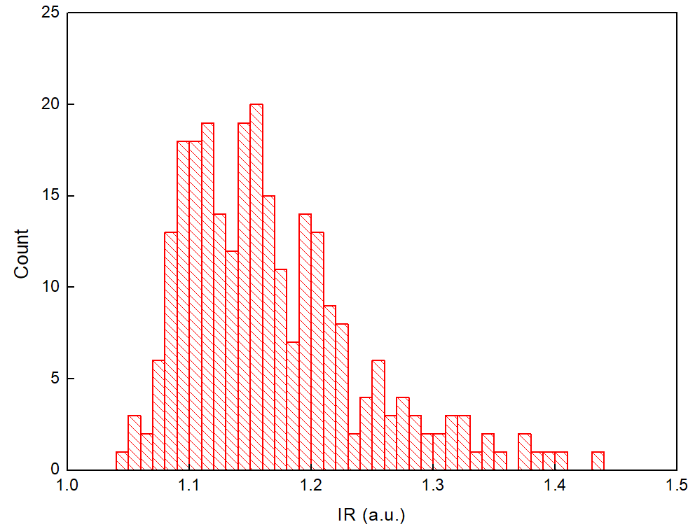
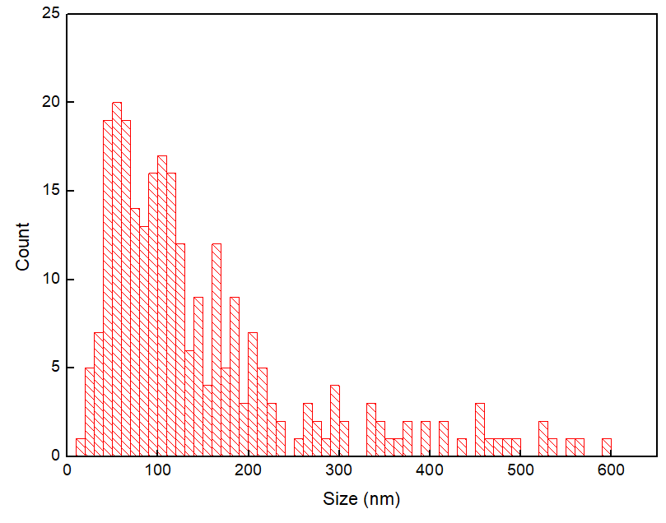
IR of detected particles from Plasma HCR 55
PANORAMA IR
1.17 ± 0.084
Particle Size
151 ± 125
derived from IR using exosome calibration curve

Slide 2
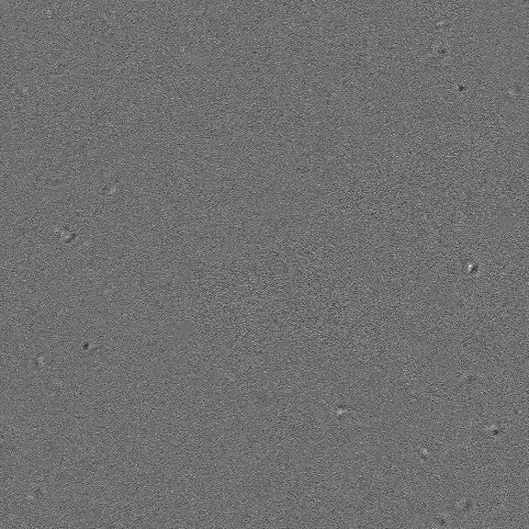

Monitoring Cancer patient Plasma 825A via PANORAMA within a single video
Time: 10 min
Particle count: 58
Size: 1.5-2.5 µm
Time: 15 min
Particle count: 89
Size: 1.5-2.5 µm
Video duration: 12 sec
Scale bar: 10 µm

Slide 3
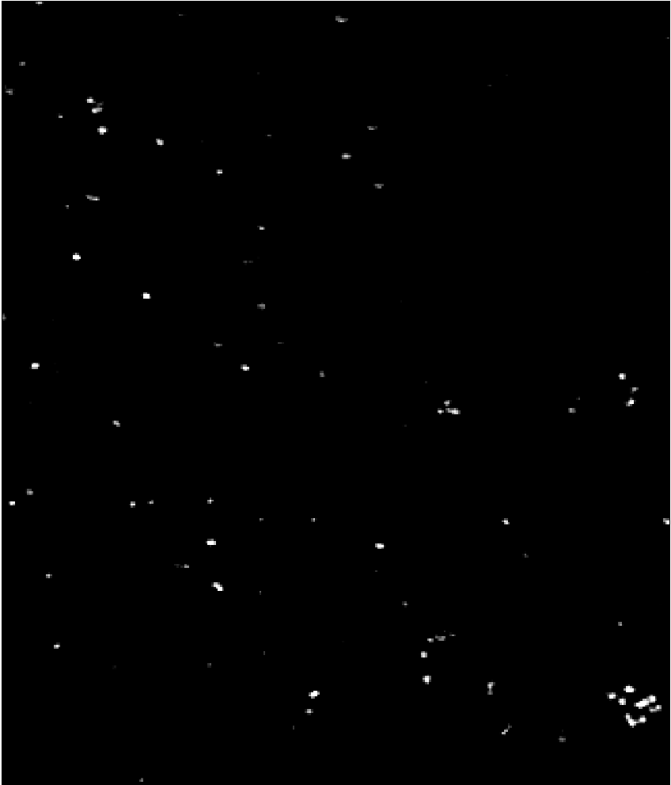
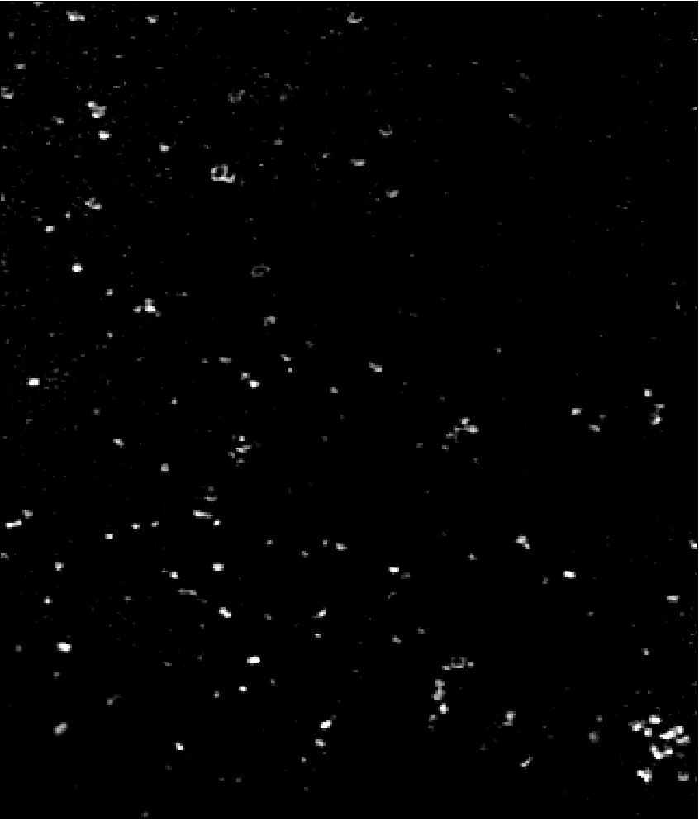
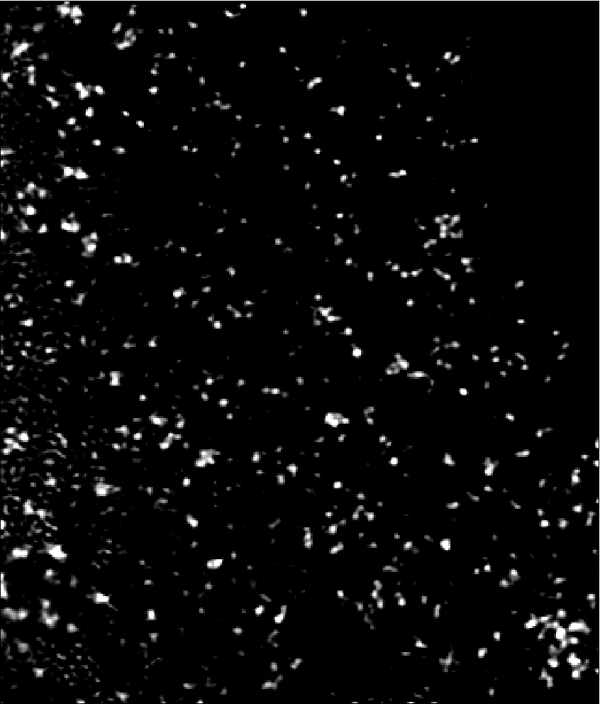
Particle settlement in time with plasma 825A
PANORAMA
Time: 1 min
Count: 128
PANORAMA
Time: 5 min
Count: 379
PANORAMA
Time: 10 min
Count: 661
Scale bar: 10 µm

Slide 4

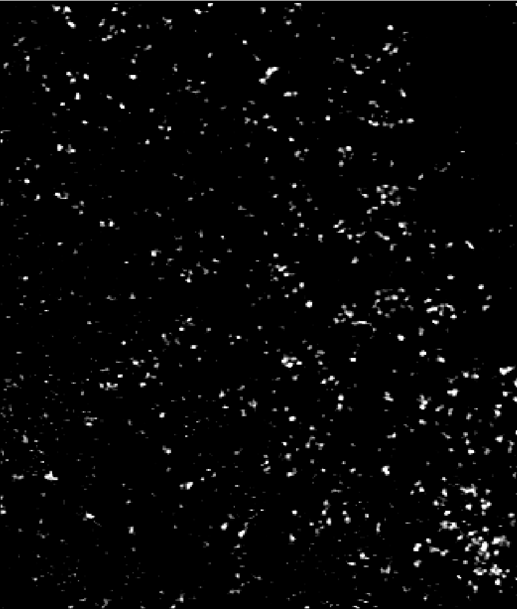
Particle settlement in time with plasma 825A
PANORAMA
Time: 15 min
Count: 862
PANORAMA
Time: 20 min
Count: 871
Scale bar: 10 µm

Slide 5
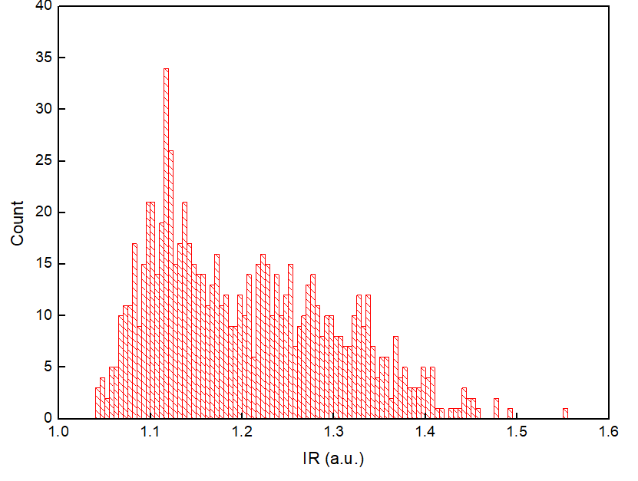
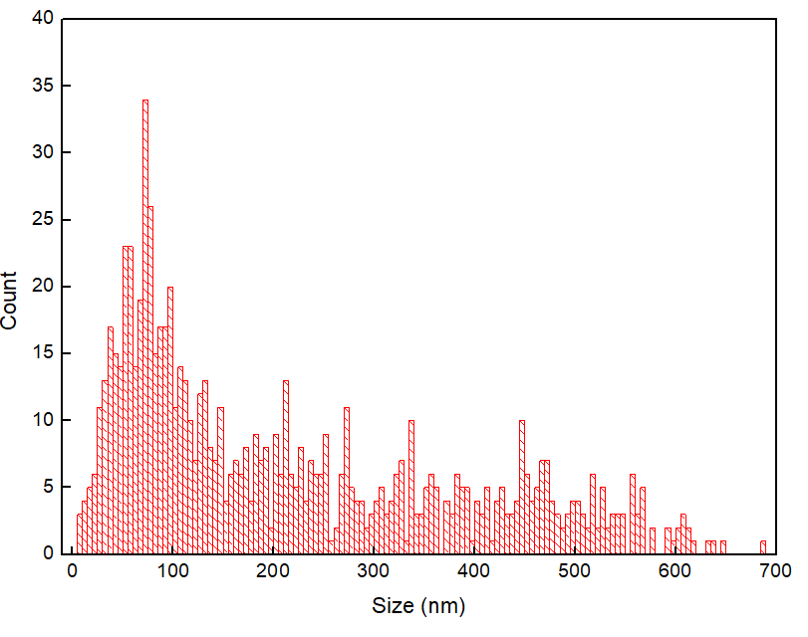
IR of detected particles from Plasma 825A
PANORAMA IR
1.20 ± 0.097
Particle Size
214 ± 165
derived from IR using exosome calibration curve

